Slide 1

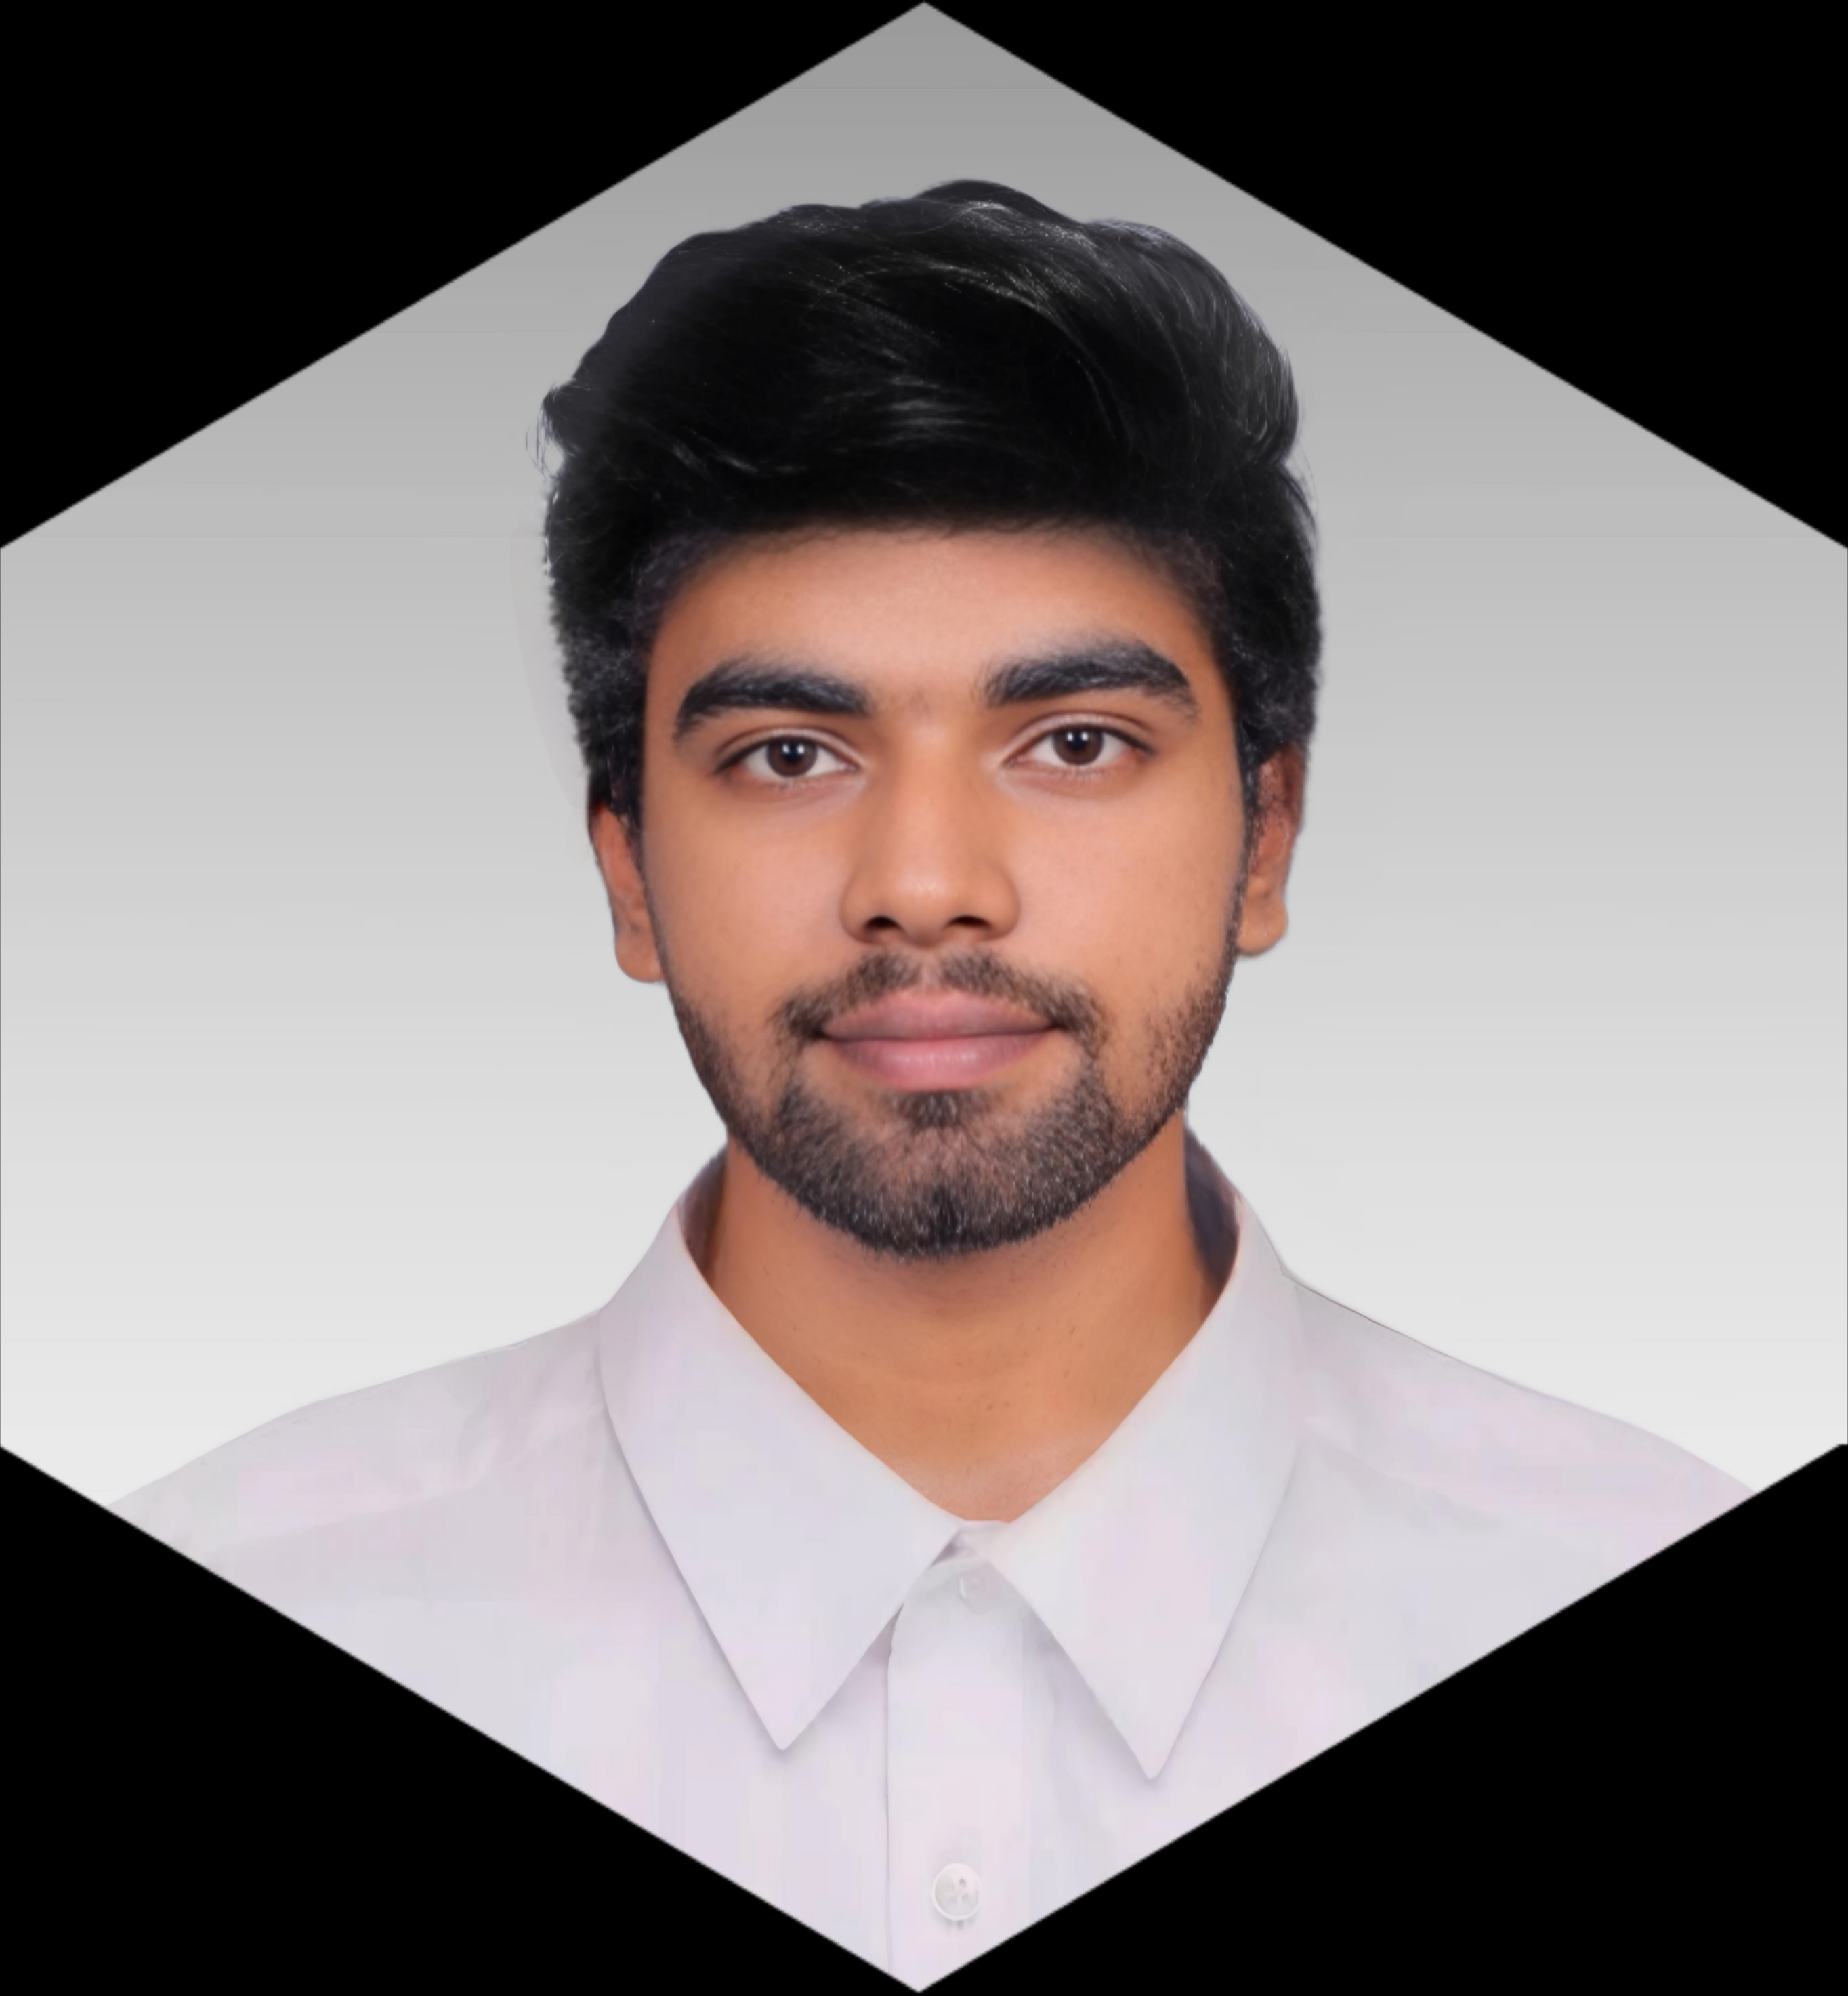






+91 82485 74408
gdhanushkumar2005@gmail.com
www.linkedin.com/in/dhanush-kumar-g-752191246
Srivilliputtur ,Tamil Nadu
EDUCATION
B.E EEE MEPCO Schlenk Engineering College.
2022-2026 Sivakasi
HSC – Srivi Lions Matric . HR . Sec . School. 83%
2021-2022 Srivilliputtur
SSC – Srivi Lions Matric . HR . Sec . School. 72%
2019-2020 Srivilliputtur
_______ _______
________
EXECUTIVE SUMMARY
B.E. Electrical and Electronics Engineering student. Adept at problem-solving, circuit design, and software development, with a keen interest in integrating hardware and software for real-world applications. Highly motivated to contribute to innovative tech-driven solutions, whether in core electronics or IT-based environments.
CGPA-7.39
PROJECTS
Dumper Tyre Management System 12/2024
Role: Sensor Calibration & UI Design
Description: Designed and implemented a real-time tyre health monitoring system for heavy-duty dumpers to prevent accidents caused by tyre failure. Utilizing React Native, Firebase, ESP32, Arduino IDE and Sensors.
Smart Buck Converter 04/2025
Role: Embedded Firmware Developer
Description: Designed and developed a smart buck converter capable of automatically adjusting output voltage based on scanned RFID tags attached to electronic components. Utilized ESP32, LM2956 Buck Converter IC, multiplexers, resistors, RFID modules, and Arduino IDE for implementation and control.
______
______
COURSES
Programming in Java (NPTEL)
Joy of Computing Using Python (NPTEL)
C Programming (ALPHA)
Solved 150+ Problems in Hacker rank
_____
TRAINING
Indian Institute of Astrophysics Kodaikanal
Completed a short-term in-plant training focused on radio interferometry and its application in astrophysics. Gained exposure to how coordinated telescope arrays are used to capture high-resolution images of celestial objects, including black holes, through techniques employed by systems like the Event Horizon Telescope (EHT).
SKILLS
Java | C | C++ | Python | PCB Design | Data Structures
_______
______
TOOLS & TECHNOLOGIES
KiCad | Arduino | Edge Impulse | Filmora
__________
ACHIEVEMENTS
Finalist, Smart India Hackathon 2024
Selected among top teams nationwide to present a tech solution in the Grand Finale round.
___________
____________
PERSONAL TRAITS
Adaptable | Socio-Friendly | Good Communicator | Problem Solving | Team Work
CERTIFICATIONS
Smart Grid: Basics to Advanced Technologies (NPTEL)
Introduction to Industry 4.0 and Industrial Internet of Things (NPTEL)
Computer Hardware (NAGA)
___________
________
LANGUAGES
Tamil | Telugu | English

